Slide 1
Rice University Mapping Project
Paige Bailey
March 12, 2015

Slide 2

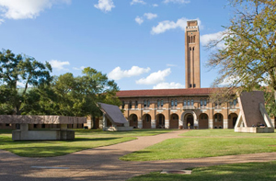
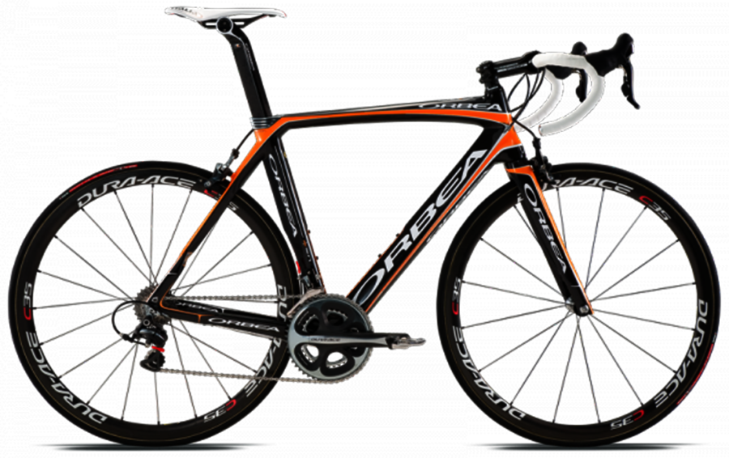
Feature Classes
Strategic Coffee Locations
Computer Labs
Public Art
Unchained Bicycles (hopefully transient?)

Slide 3
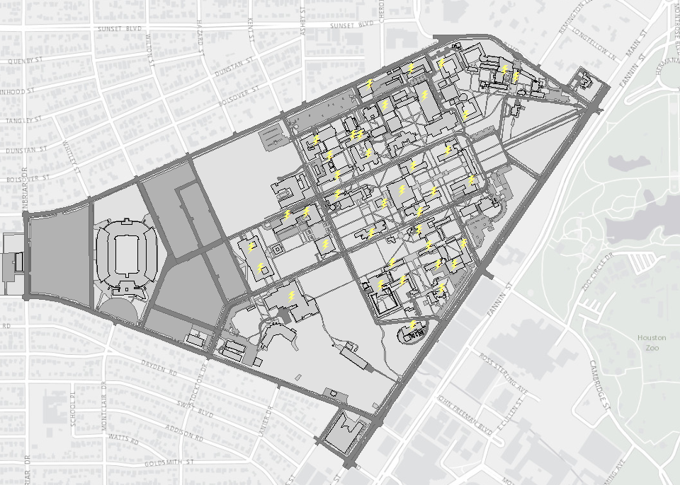
Strategic Coffee Locations
Building
Whether you need special access after business hours
Free (Y / N)
Do you need to use your own mug (Y/N)
Room Number
“Grade” of coffee
A (good!)
B (decent)
C (last resort)
D (how does this even qualify as coffee)

Slide 4

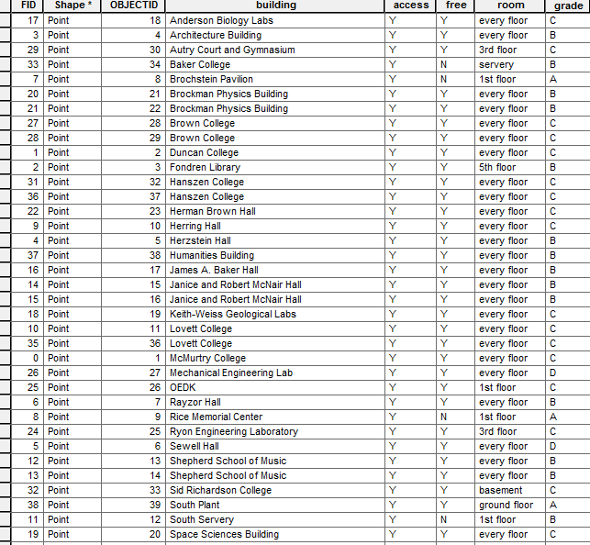
Analysis, Pt. 2
“Given my access level, and given the time of day, where is the closest location I can obtain coffee?”
“If I have no money during standard business hours, where can I obtain the highest grade of coffee?”

Slide 5
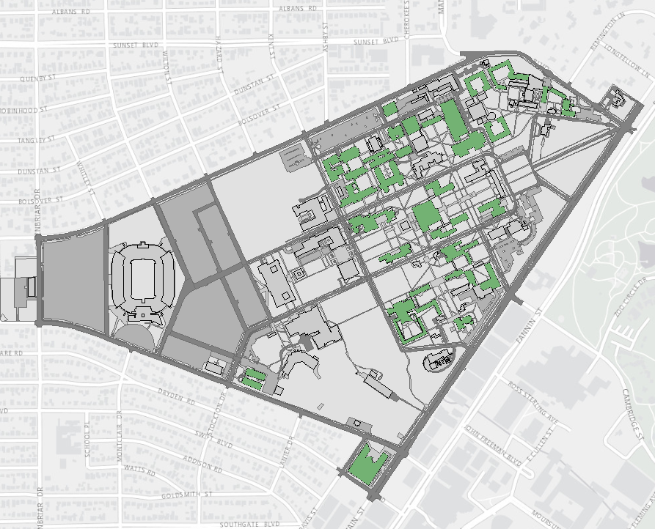
Computer Labs
Building name
Whether you need special access after business hours
Capacity
Operating System
Windows
Mac
Linux capable
Room number

Slide 6
Analysis
Huge thanks to the IT Help Desk for getting me a comprehensive list of all the labs they support:
http://edtech.rice.edu/www/?option=com_iricetv
Most departments have computer labs specifically for their students, accessible 24/7 if you have a valid ID
Most labs are Windows or a combination of Windows and Mac
Speed of hardware varies greatly across different departments
Earth Sciences, OEDK, Duncan, and Mudd Lab are most impressive
Sewell Lab, RMC, and the Humanities labs = not so much

Slide 7
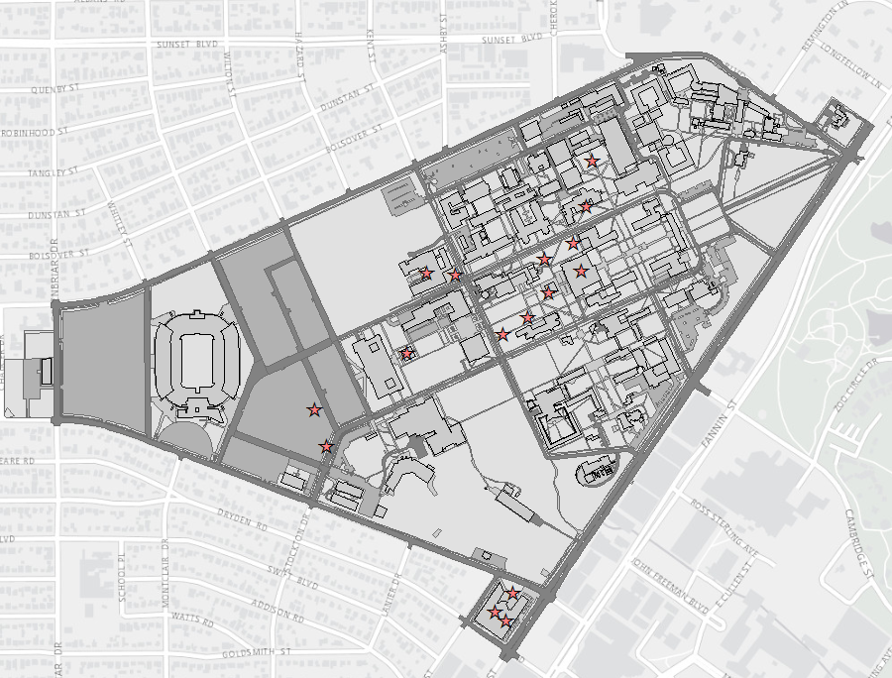
Public Art
Used this one for the GPS coordinates (lat, long)
Artist name
Piece name
Medium
Sculpture
Photo
Painting
Indoors or outdoors
Year created

Slide 8
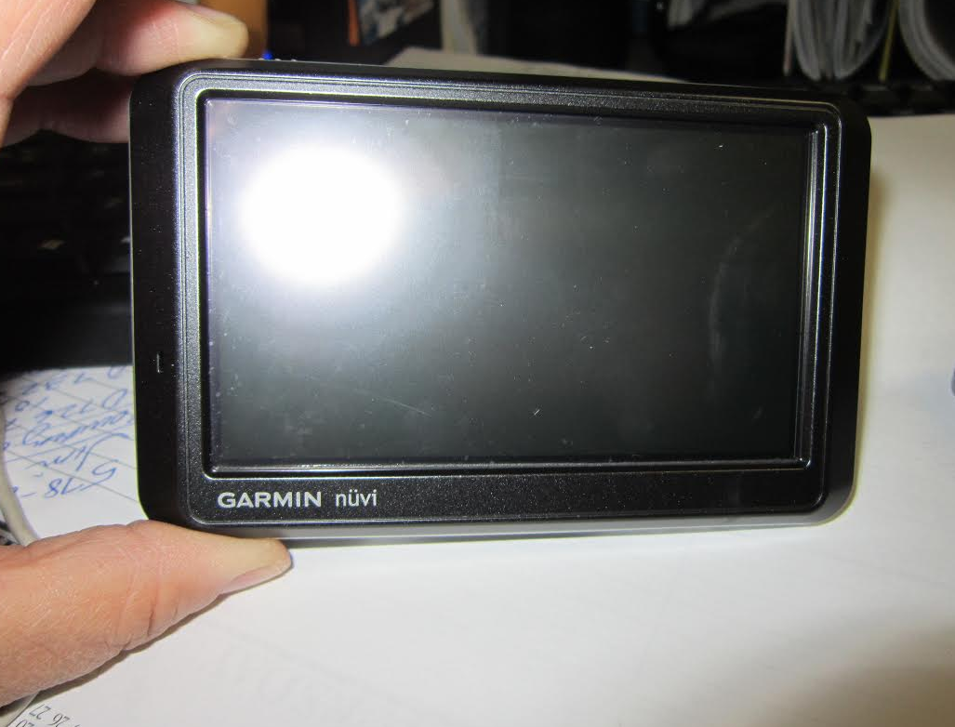
GPS Tool Used
Garmin nuvi 760 (ca. 2007)
Most measurements were consistently off (when mapped, ~15ft east and ~10ft north)
Many Houston roads have also not been added to its database
Cell phone’s GPS measurements were more accurate

Slide 9
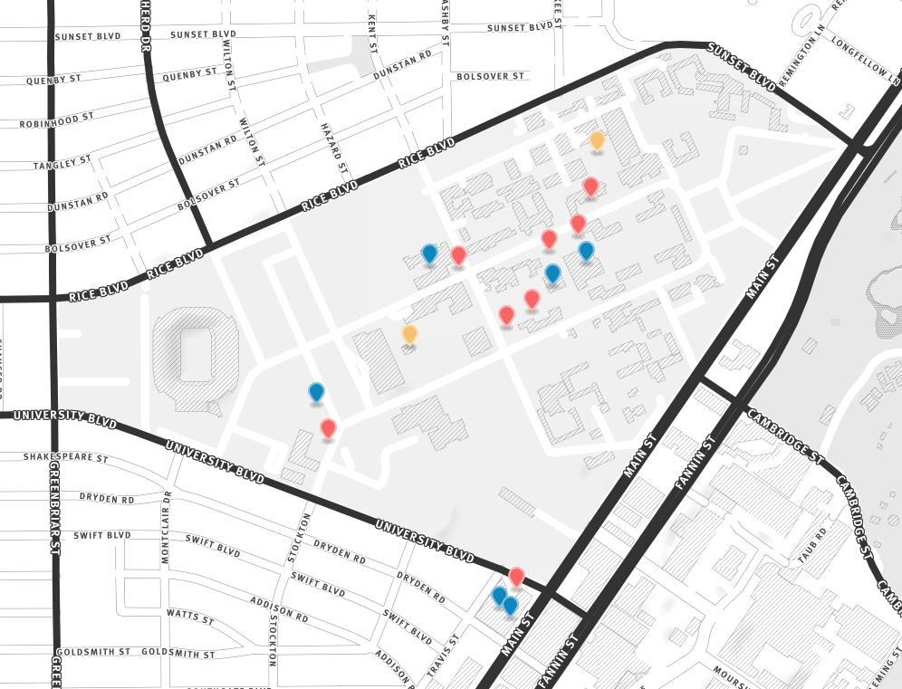
analysis
Vast majority of art pieces are sculptures, and outdoors
Also placed a version of the map on MapBox, with pictures of the art if you want to access it
More information:
https://api.tiles.mapbox.com/v4/dynamicwebpaige.h267k92e/page.html?access_token=pk.eyJ1IjoiZHluYW1pY3dlYnBhaWdlIiwiYSI6ImJKZzl6NHcifQ.Fv24YqwbSLpbzJVk3oIMMg#16/29.7173/-95.4044

Slide 10
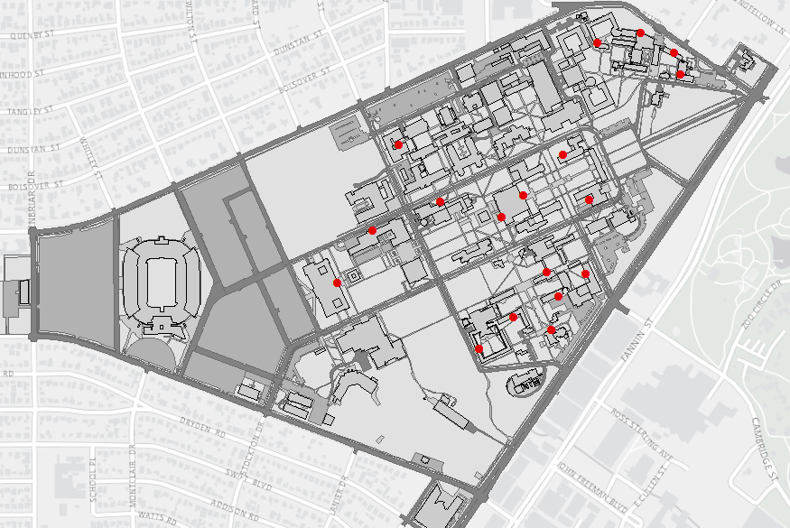
Unchained Bicycles
Brand
Trek
Specialized
Giant
Bianchi
Huff-E
Schwinn
Number (lots!)
Colors
Date
Time

Slide 11
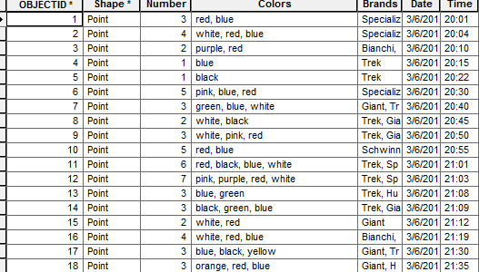
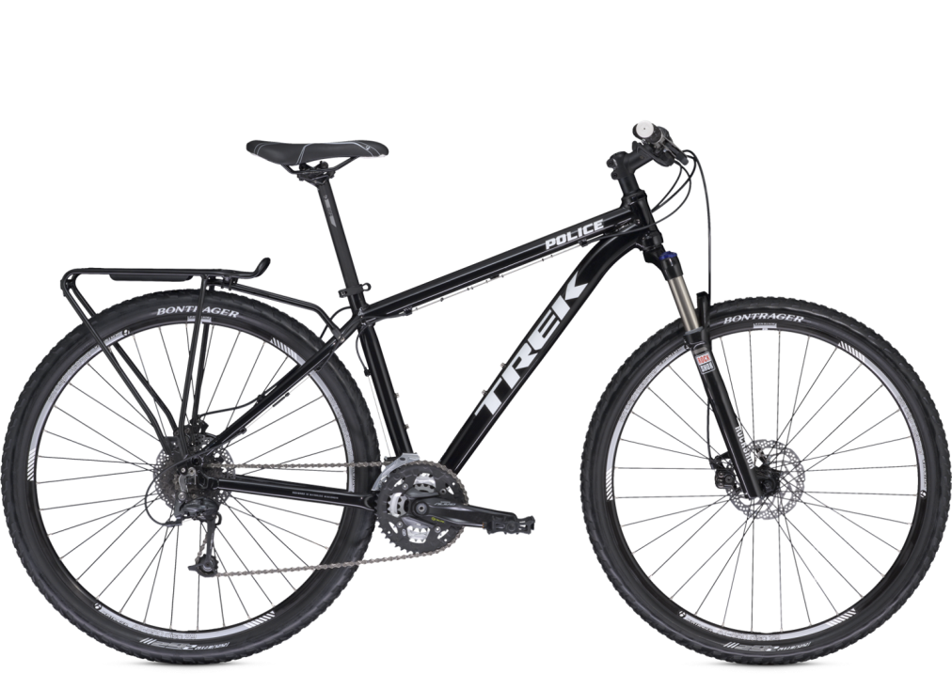
Analysis
RUPD will think you’re trying to steal things if you walk around campus at night during spring break pulling at bike chains
Blue and red are the most common colors
Trek, Giant, and HuffE are the most common brands
Higher quality bikes are more likely to be securely chained
60 unchained bikes total

Slide 12
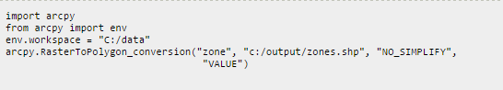
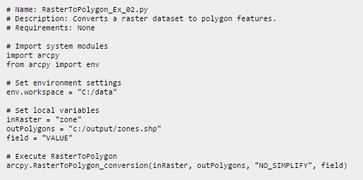
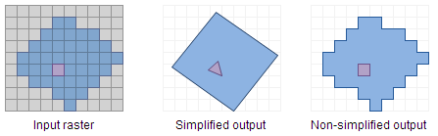
Lagniappe (Geoprocessing with Python)
Geological map had a lot of pointing and clicking
Wanted to see if there was a better way
Starting in ArcGIS 10.2, there’s a way to change a raster to a polygon automatically

Slide 13
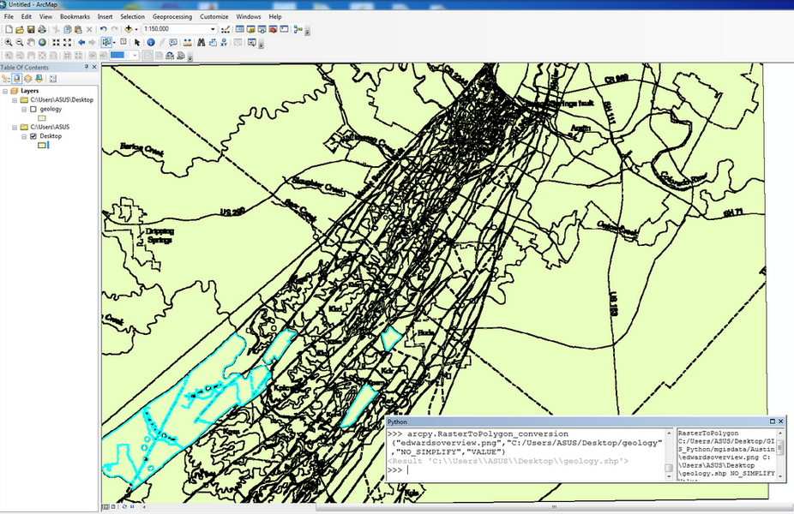
Lagniappe (Geoprocessing with Python)

Slide 14
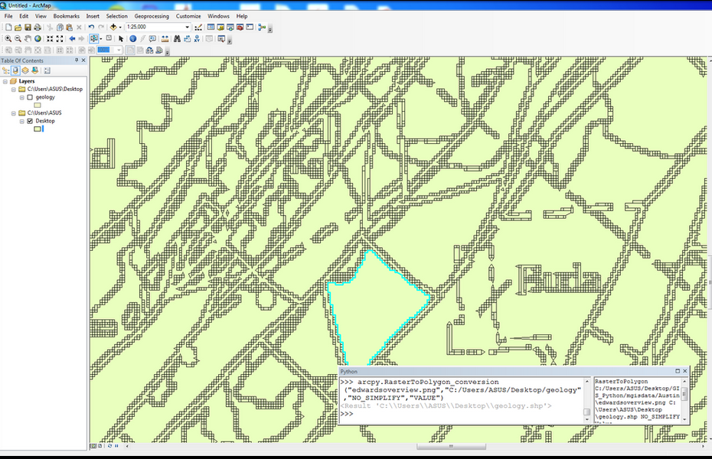
Lagniappe (Geoprocessing with Python)

Slide 15
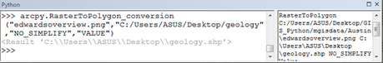


Geoprocessing with Python: Next STeps
Want to see if there’s a better way to pre-process CAD / “picture” files to hone lines before importing to Arc
Would be awesome to use OpenCV and arcpy externally without launching GIS application

Slide 16
Thanks!
All data available via GitHub
GeoJSON
.shp
.qgs
.mxd

